Slide 1
SAP BTP Extension Suite Training
Day 18
Anubhav Oberoy
www.AnubhavTrainings.com
Follow excellence with sheer passion

Slide 2


DISCLAIMER
The training content and delivery of this presentation is confidential, and cannot be recorded, or copied and distributed to any third party, without the written consent of Anubhav Trainings

Slide 3
Agenda – Day 18
01
Add another UI inside app
02
Working with Authorization
03
Serverless Fiori Apps

Slide 4
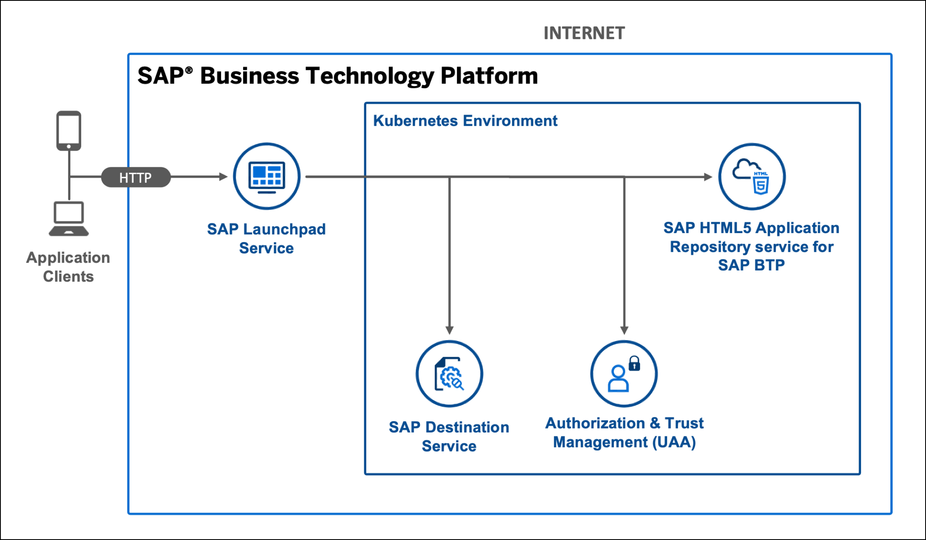
Serverless Fiori App

Slide 5
Serverless Fiori Apps
Hi Anubhav, when we have multiple FIoRI apps in the same capm service,
we have to create roles for all the FIoRI apps in the same xs-security.json and have to assign it to relevant app users right ?
Since these are independent apps, the security also needs to manage independently. Each app has its own xs-security file.
Also when we build multiple fiori apps, we will have multiple ui micro services for the same cap app right ?
No, CAP app has its own microservice. You have these loosely coupled Fiori apps which are indepent apps.
cds outbox messages pls show us how we can have different message displayed to the user.I checked in the google,but couldn't find example on it
Let me explore and come back ☺
one doubt regarding HDI microservice.with CICD and CTMS we are anyway deploying in Dev again and then release to QA. Can we avoid manual deployment first ( Mickey service ) .
Yes, you can but if you don’t do mickey, how you test whether your app after deployment will work with HANA or not?
Use CTMS to deploy in dev as well , test and then release to QA. is there any disadvantage if we do this way.
No

Slide 6
Fiori on Cloud Recipe ingredients 3X3
Modules
Our application (html5 module) – it is our actual Fiori app, when we build the mta_archieve, this will also package all the Fiori app content in a zip file.
HTML5 Content Deployer (app content)– this module will be used to take the zip file of our Fiori app and usage the html5-repo-host service and store our app in BTP HTML5 Repository.
Destination Content – The module will use the destination service and creates the destination for html5-repo-host service and auth (xsuaa) service which later will be used by managed app router hence by build workzone and our app.
Resources
html5-repo-host service – this will be used by Build workzone and managed app router to load our Fiori app deployed in html5 repository @ Runtime when user tries to load our app.
Destination-service – this service will contain all the destinations inside and help app and managed app router to locate other services @ Runtime
Auth service (xsuaa) – so our app can call the XSUAA for JWT token for authentication.
Managed App Router (built-in in BTP) – it is a built-in, FREE, app router provided by SAP in BTP. Which is responsible to communicate between all microservices of our Fiori UIs. It is used by build work zone (Fiori Launchpad). There is also a successor of managed app router called as Application frontend service.

Slide 7




Persona
BTP Admin (Anubhav)
BTP Developer (Rohan)
Application Admin (Subbu)
Business users (Raj, Sonia, Rob, Sajeev, Bhagya)
Subscribe to different services
Configure entitlements
Create Subscriptions
Create Roles
Manage Users in company
Manages environment, spaces
Create destinations
Configure Landscape in CTMS
Configure SAP BTP Cloud Identity service and Appoints Subu as Application Admin
Create Trust Relation between Cloud Identity Service and BTP Sub Account
Subscribe to SAP Build Workzone and give access to developer and also to App Admin
Send email to Subu for build workzone
Use BAS tool
Create Fiori on Cloud App
Create CAPM app
Deploy App
Push code to git
Configure Backing service
Testing and deployment
Manage Applications
Configure tiles for Build Workzone
Already created a Fiori on Cloud Application, Will deploy this app to BTP in HTML5 Repository
Admin for Business users
Create Application role
Create Role Collections
Register business users
Reset their passwords
Configure Company SSO with BTP
Grant Role Collections to business users
Give access to Build workzone app to business users
Grant Fiori App Access to business users
Receives email and access SAP Build Work zone
Login to BWZ and configure a site
Fetch the apps deployed by deb to html5-repo
Check slide
They are using actual apps in their respective departments
Create Sales order
Create purchase order
Manage Service contract
….

Slide 8
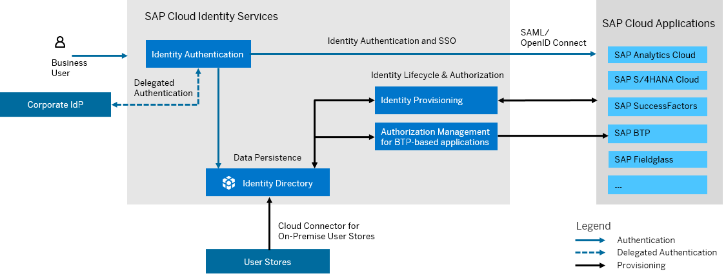
What is SAP Cloud Identity Service?
SAP Cloud Identity Services are a group of services of SAP Business Technology Platform (SAP BTP), which enable you to integrate identity and access management between systems. The goal is to provide a seamless single sign-on experience across systems while ensuring that system and data access are secure. SAP Cloud Identity Services include Identity Authentication, Identity Provisioning, Identity Directory and Authorization Management.

Slide 9
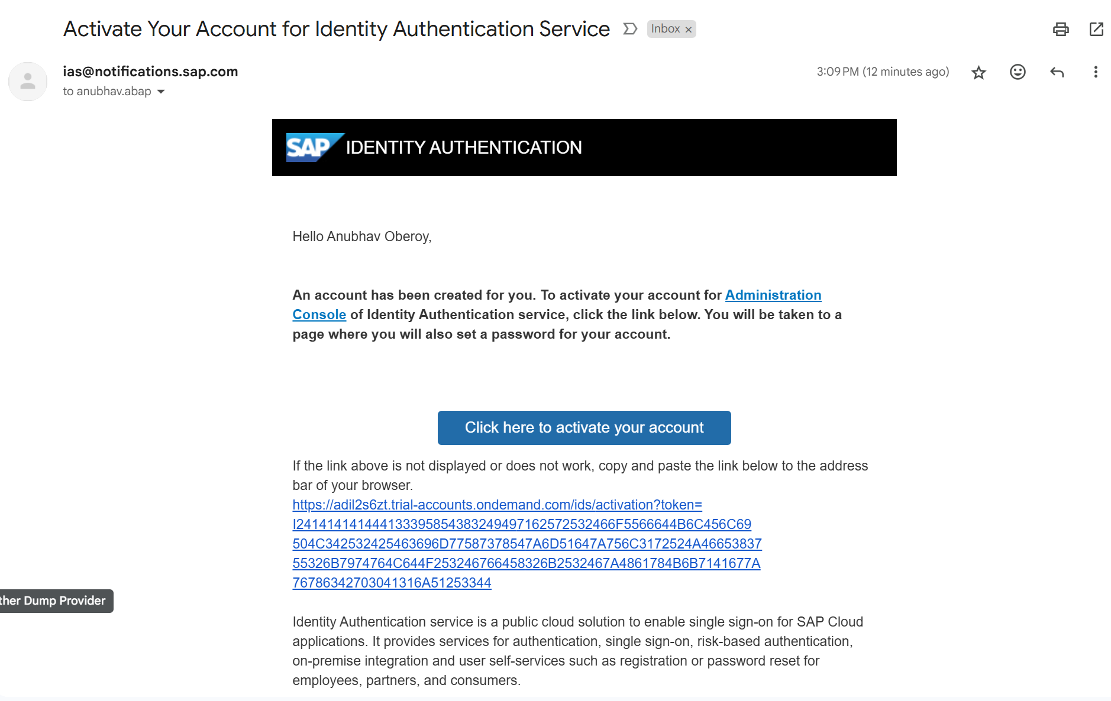
Become Admin for your Identity Service

Slide 10
How to configure Build Workzone
Receives email and access SAP Build Work zone
Login to BWZ and configure a site
Fetch the apps deployed by developer to html5-repo from the channel manager
Go to content explorer>HTML5 Explorer> Import the app for the user in the Content Manager
Import the app to the Content Explorer and the app is now available [ToDo: Next session Anubhav has to show our deployed html5 app instead the mock app]
Create a catalog – Collection of tiles, Add all apps to the catalog and save
Create a group – Providing meaningful grouping of apps for easy navigation e.g. Employee, Manager etc.
Create a role – once granted to our business users they can access the app
Open the site settings, and perform role assignment to the site
----
Registers the business user
[BU] Receives and email and activates his/her SAP account with SAP Custom Idp (Cloud Identity Service)
Grant the business user access to our Role and Launchpad external user role so they can access our apps
Share the link of the business site with the user which when they open, they can consume applications.
[BU] Goes and access the launchpad (site)
https://help.sap.com/docs/cloud-identity-services/cloud-identity-services/configure-idp-initiated-sso
https://help.sap.com/docs/btp/sap-business-technology-platform/developing-with-sap-cloud-application-programming-model

Slide 11
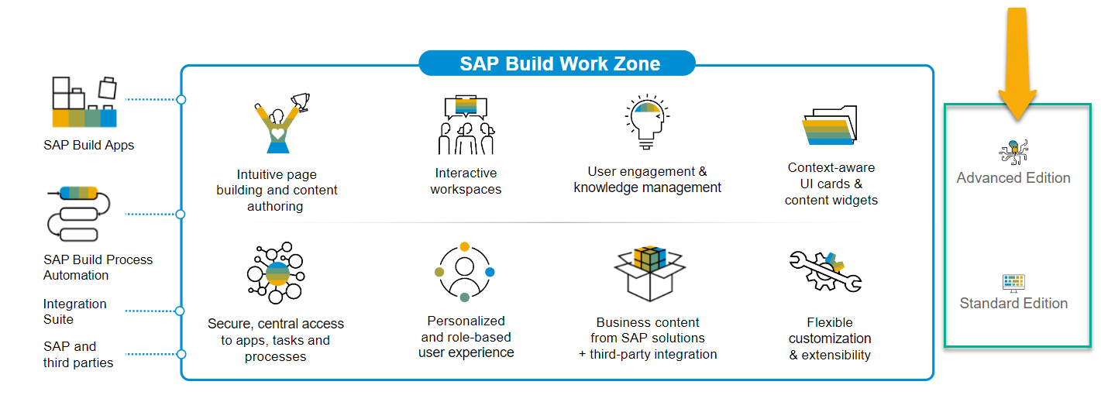
SAP Build Work Zone?
SAP Build Work Zone, is a powerful SAP Business Technology Platform service that consists of several components to integrate cloud and on-premise applications onto a single page including site designing capabilities.
SAP Launchpad Services is now called SAP Build Work Zone, Standard

Slide 12

Hands-on Setting up Build Work Zone

Slide 13
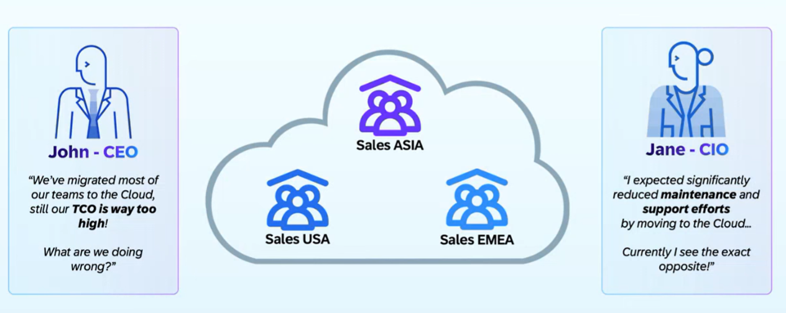
Why Multi-tenant App?

Slide 14
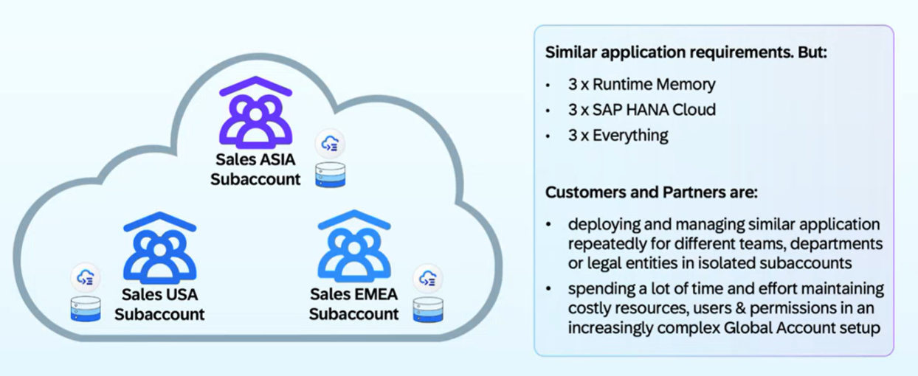
Common Challenges

Slide 15
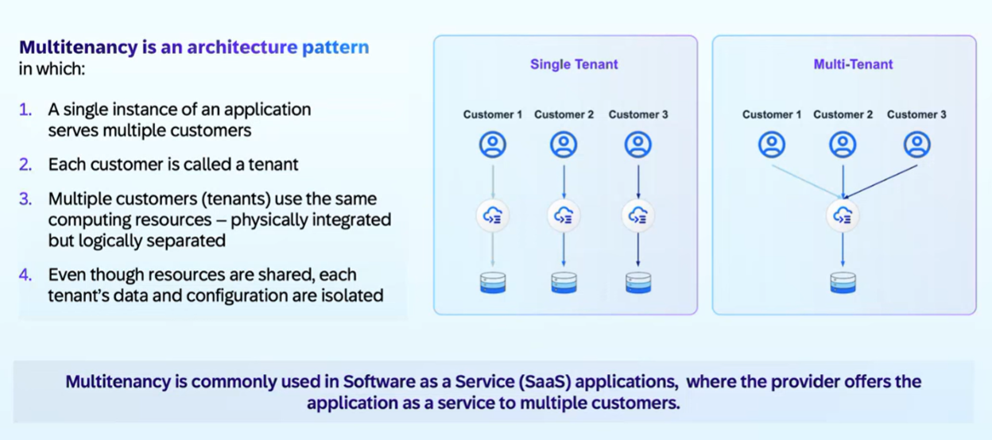
What is Multitenant - SaaS

Slide 16
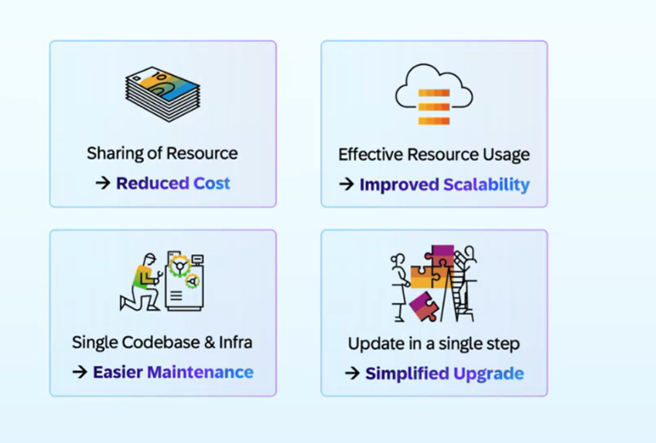
Benefits of Multi tenant App

Slide 17
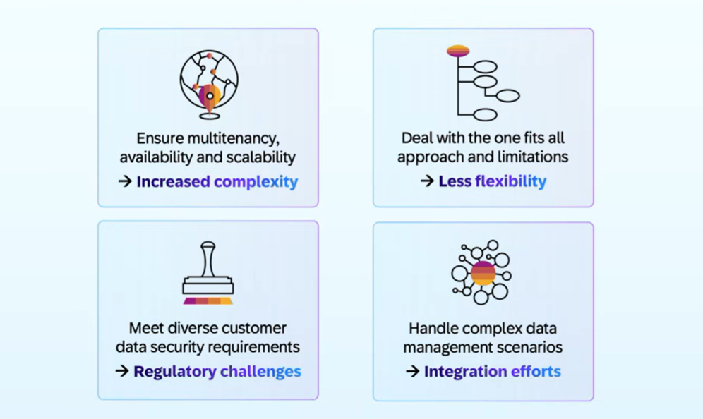
Challenges

Slide 18
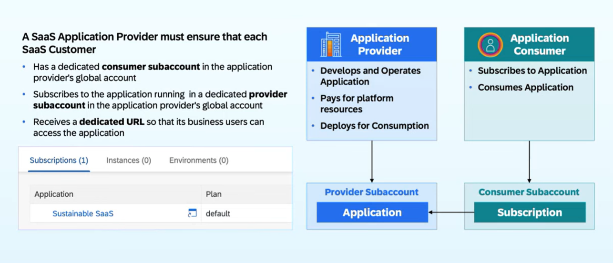
How it works in BTP?

Slide 19






















Slide 20
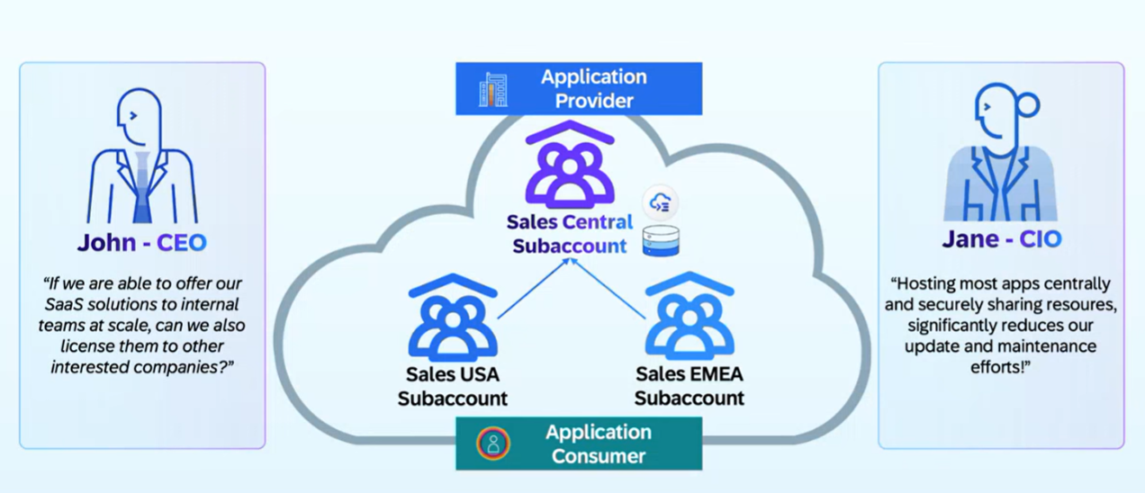
SAP Customer Perspective

Slide 21
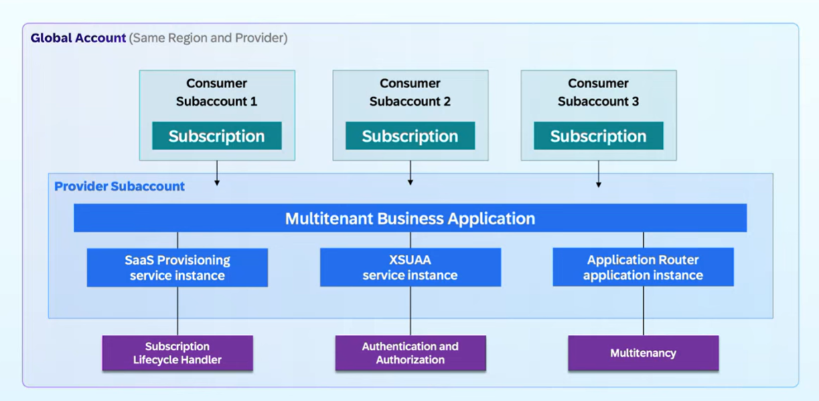
Multi-tenant App on BTP

Slide 22
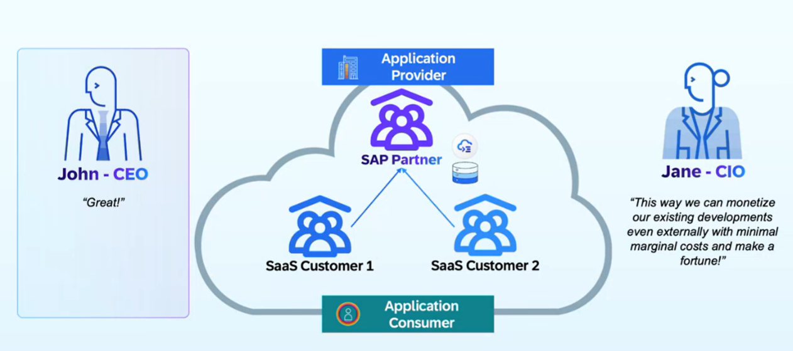
Partner Solutions

Slide 23
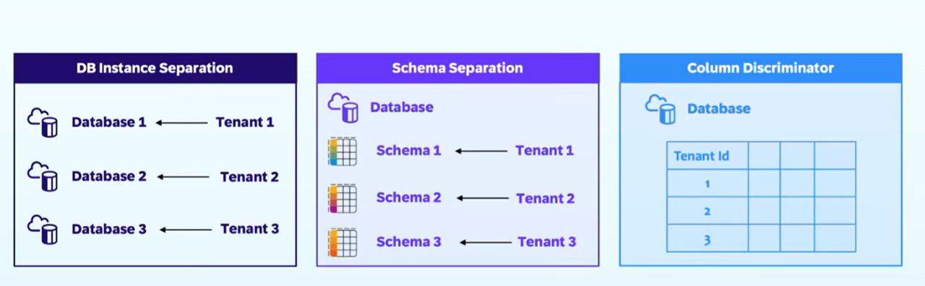
Data Separation for Multi tenant Apps

Slide 24
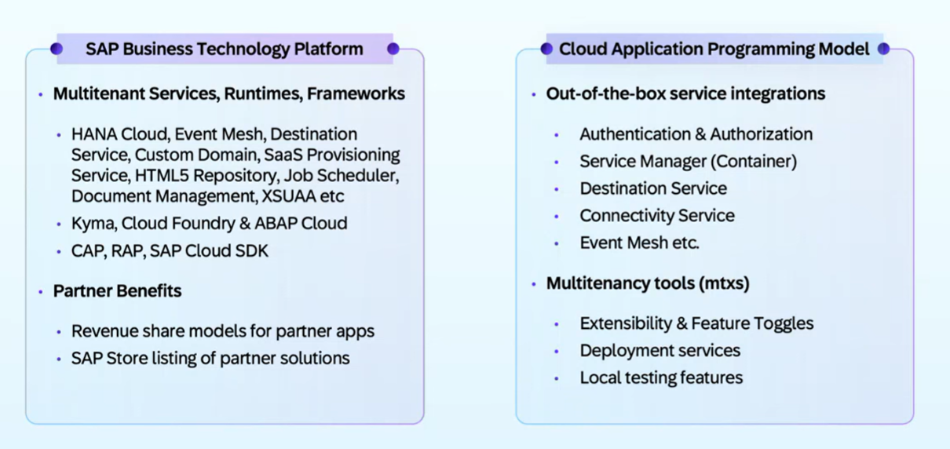
SAP BTP Offerings

Slide 25
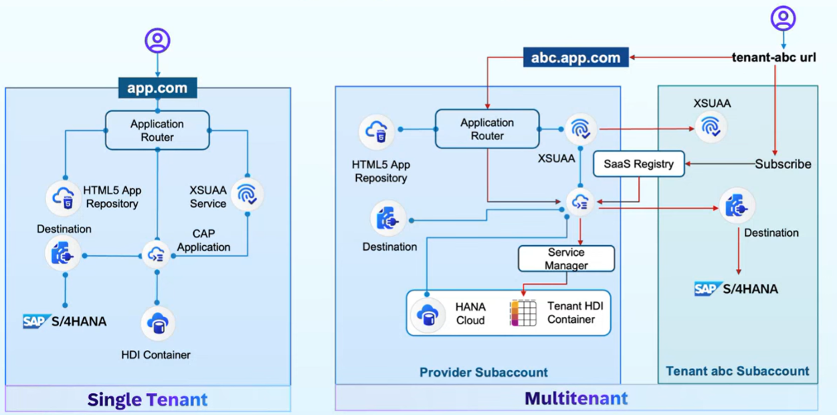
Multi Tenant App – Architecture with CAP

Slide 27

What We Did
Let’s Summarize

Slide 28

www.anubhavtrainings.com
Thank You
End of Day 6

Slide 29


We’re committed to empower you to be
#FutureReady
through powerful training solutions.
We build the workforce of the future.
260+
Corporate Clients
60,000+
Learners Trained
26000+
Learners Placed
FREE WEBINARS
Sign up for free webinars with industry experts every fortnight!
Enroll Now!
Contact us today!
https://anubhavtrainings.com

